Slide 1



DATA PLACER
DATA CENTRE OPTIMIZATION

Slide 2






Climate
User Input
Planner / Feedback
Candidate Generation
Energy
Cost Analysis
Feasibility & Result
…
Land

Slide 3
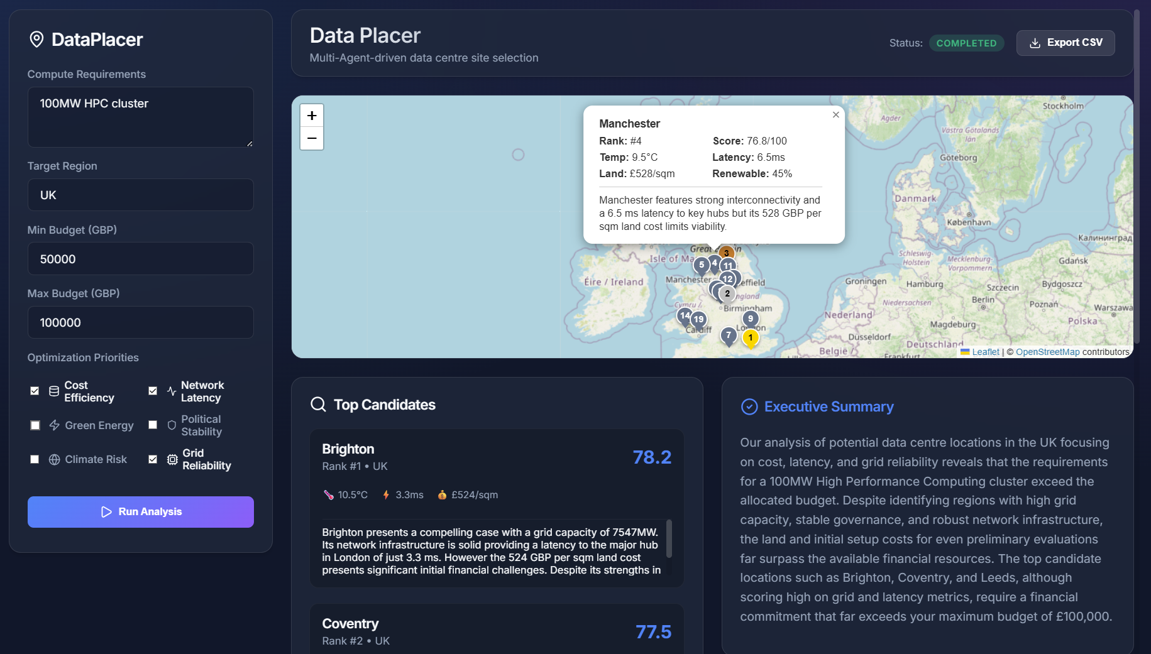

Slide 4
Energy Sources
User Input
Planner
Candidate Generation
…
Cost Aggregator
Feasibility & Output
Brownfield Sites

Slide 5
Energy Sources
User Input
Planner
Candidate Generation
…
Cost Aggregator
Feasibility & Output
Brownfield Sites

Slide 6
